Slide 1
follow along? aka.ms/getAzureDataStudio github.com/MsSQLgirl/jubilant-data-wizards

Slide 2







Thank You to our Global SQLSaturday Sponsors

Slide 3

Thank You to our Local SQLSaturday Sponsors

Slide 4

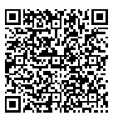

Kusto Query Language in Azure Data Studio
SQL Saturday Singapore #1019 Nov 28, 2020
KQL
Raffle Prize + Evaluation Form https://bit.ly/3q9ncNu
Julie Koesmarno (@MsSQLGirl)
Program Manager, Microsoft
jukoesma@microsoft.com

Slide 5





I’m a SQL DBA. Is KQL relevant for me?
Suki
I’m an app dev on Azure. Why KQL?
Dev
I’m a Data Engineer. How do I use KQL?
I’m at a SQL Saturday, why am I learning KQL?
Roger
Azure Services

Slide 6

Our learning journey today
1
2
KQL meets Azure Data Studio
KQL – a quick recap
3
Native Kusto in Azure Data Studio
4
Kqlmagic in Azure Data Studio
🥡
Basic knowledge assumed -
KQL syntax,
Azure Monitor / Azure Data Explorer
Takeaways & Resources

Slide 7
1
KQL – a quick recap

Slide 8





Kusto Query Language
Optimized query language with visualization options
For fast read-only data retrieval
Troubleshooting & deep diagnostics
Real-time stream / big data analytics
Use KQL to connect and query these Azure Services:
…
Azure Monitor
Log Analytics
App Insights
Resource Graph
Azure Data Explorer

Slide 9



KQL
KQL Scripts
read data
Azure SQL DB
OR
event log
Notebook with KQL
Executable
Parameterizable (Kqlmagic)
Automatable (Kqlmagic)
Log Analytics
Use Case #1: SQL DB
Azure Monitor

Slide 10
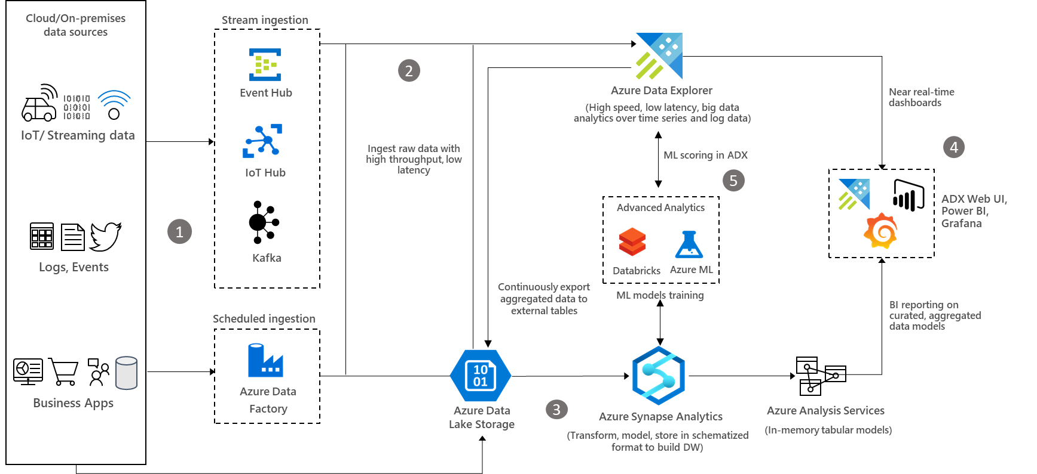
Use Case #2: Big Data Analytics

Slide 11

How others use KQL and Notebooks?
Monitoring and analysis of Microsoft Dynamics 365 Business Central https://never-stop-learning.de/monitoring-telemetry-with-jupyter-notebook/
To see if any of the destination IPs are listed as potential malicious ones https://www.managedsentinel.com/2019/05/30/azure-sentinel-notebooks/
Interactive Troubleshooting Guides for Dynamics 365 Business Central : https://github.com/microsoft/BCTech/tree/master/samples/AppInsights/TroubleShootingGuides#learning-resources-azure-data-studio
Image Source: https://www.managedsentinel.com/2019/05/30/azure-sentinel-notebooks/

Slide 12

Tools
Azure Portal http://portal.azure.com
Data Explorer https://dataexplorer.azure.com/
Since Apr 2020:
Azure Data Studio with Kusto Experiences http://aka.ms/getAzureDataStudio

Slide 13
2 KQL meets Azure Data Studio

Slide 14

Azure Data Studio
Modern data experiences, multi data-platforms SQL: SQL Server, PostgreSQL, Azure SQL Edge, Azure SQL* KQL: Azure Data Explorer Environment: On-premises, poly-cloud
Client tool on multi-platforms: Windows, Linux, macOS
Extensible tool
Git support
Jupyter Notebook experiences
… and more …

Slide 15
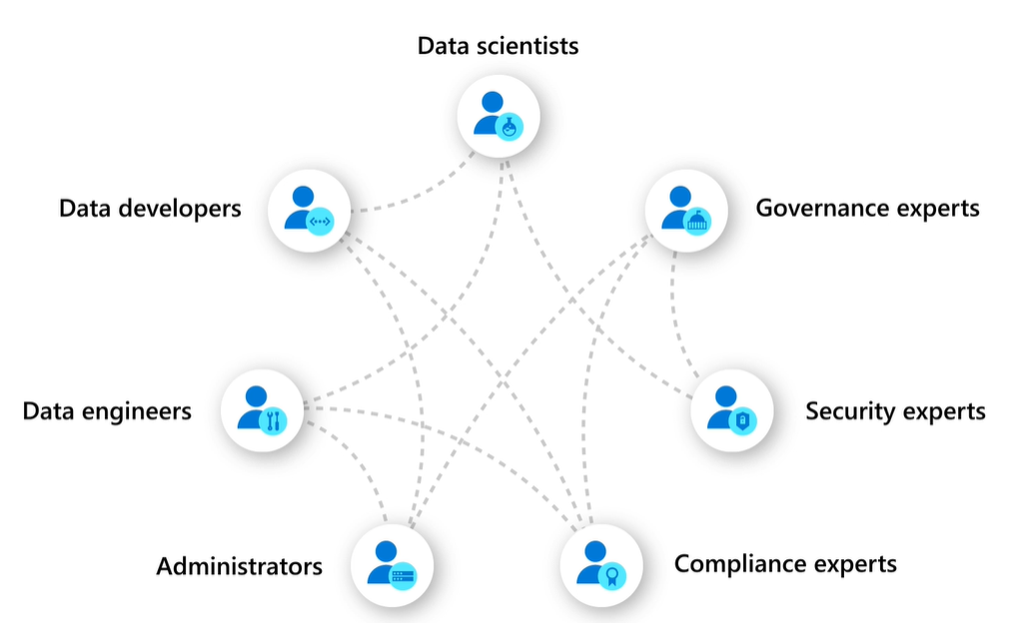
Client tool on multi-platforms: Windows, Linux, macOS
Extensible tool
Git support
Jupyter Notebook experiences
… and more …
Azure Data Studio

Slide 16

Azure Data Studio enhancements – a quick glance
Azure Arc preview support
Azure SQL Edge general availability support
Azure Data Explorer / Kusto (KQL) extension
SQL Database Projects extension
New Jupyter Book support
Rich Text notebook editing mode
Notebook search experience
Jupyter Books picker
Drag and Drop Tables in Query Editor
Improved Azure Data Studio dashboards
KQL Magic support in Notebooks
Markdown toolbar for Notebooks
Welcome page
Postgres extension update
Creating Jupyter Book support
Charting support for SQL Notebooks
Find in Notebook
Improved Azure sign in support
Feature tour
Support for MongoDB and Teradata for Data Virtualization extension
SQL Assessment API extension
Azure Data Studio to Azure Portal integration
Support for parameterization for Always Encrypted
Python dependencies wizard
Machine learning extension
Redgate SQL Prompt extension
Support for Always Encrypted

Slide 17

KQL experiences in Azure Data Studio
1. Native Kusto experience
Acquisition: Kusto (KQL) extension
Connect & browse Azure Data Explorer (ADX)
KQL Query + intellisense
Native Kusto notebooks
2. Kqlmagic in Notebooks
Acquisition: Python package
Integrated notebook experience in Python
ADX, Log Analytics, App Insights

Slide 18
3 Native Kusto in Azure Data Studio

Slide 19
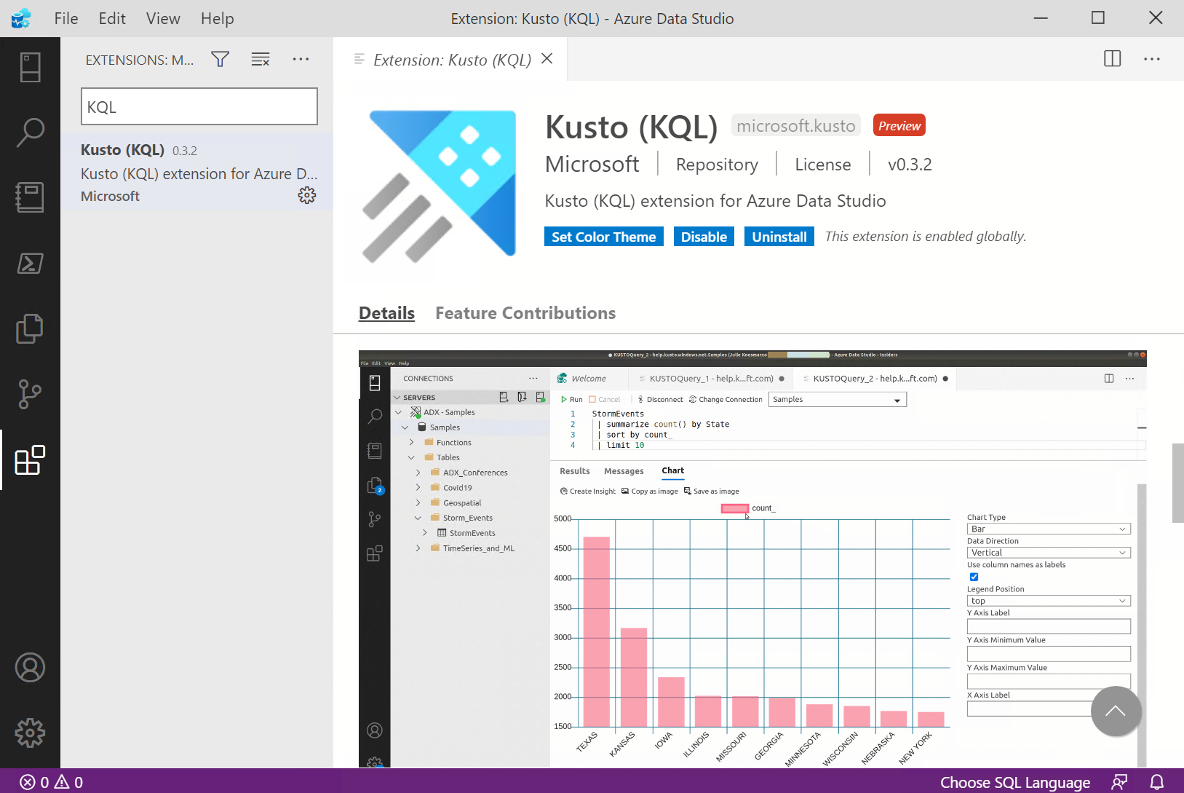
Install Kusto (KQL) extension

Slide 20
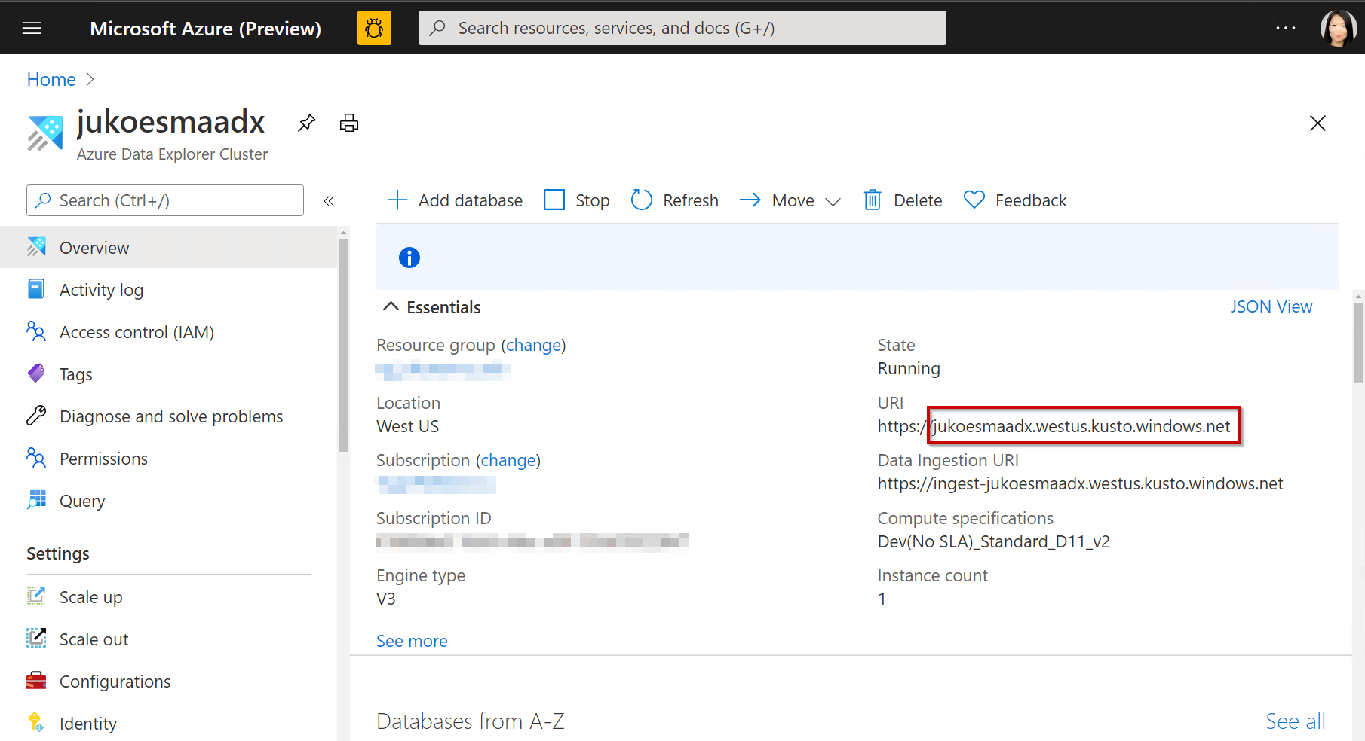
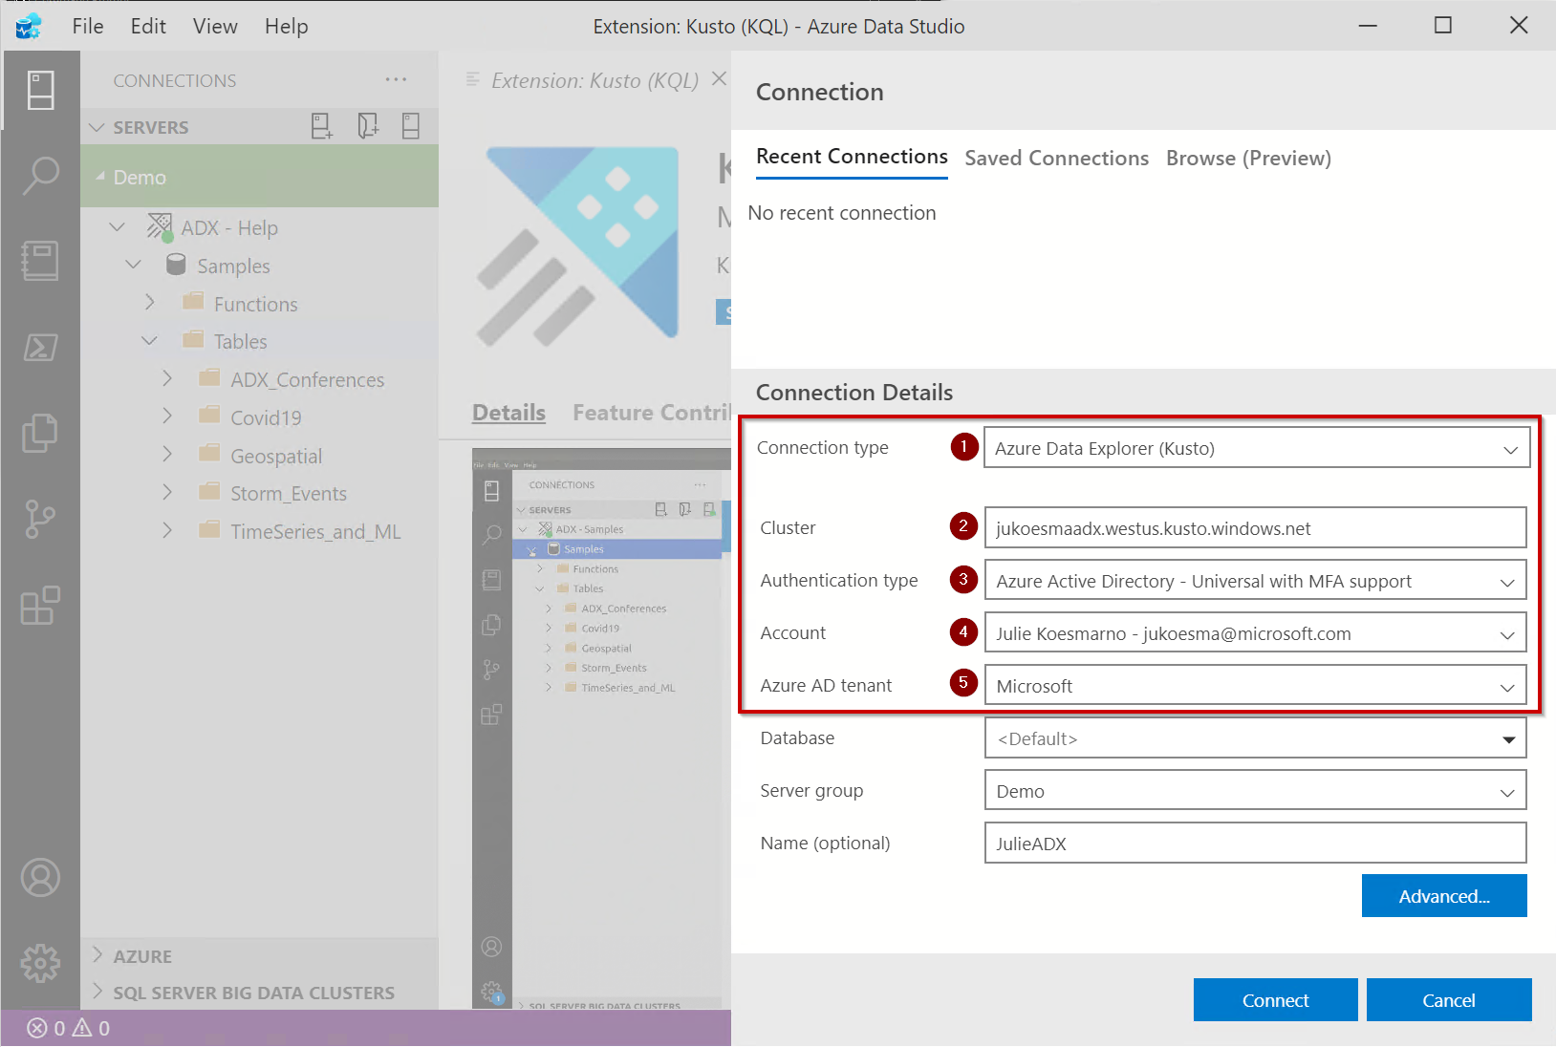
Azure Portal
Azure Data Studio Connection Wizard
Connect to ADX

Slide 21
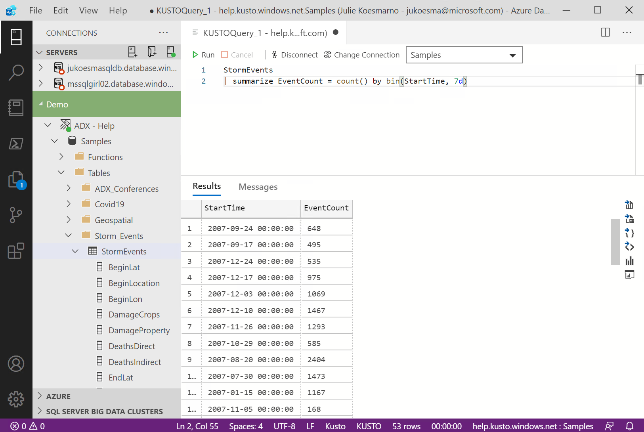
Native Kusto experience
Connections
Notebooks
Object Explorer
Query Editor
Source Control
Result Set
Extensions
Actions on Result Set
Linked Account

Slide 22
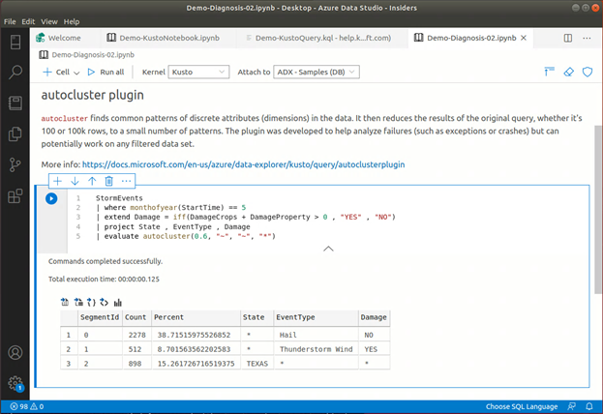
Notebooks
Text cells
Code cells
SQL
PowerShell
Python
KQL
.NET interactive
Notes:
JULIE

Slide 23
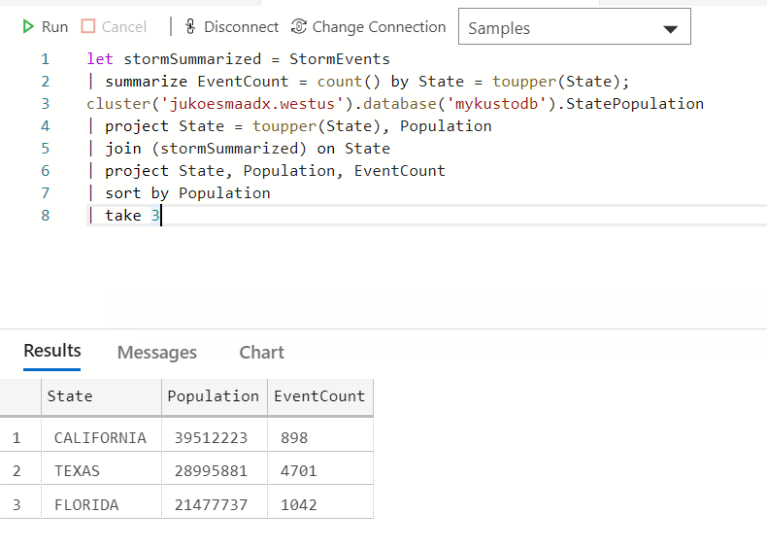
Cross database / cluster call & joins in Azure Data Explorer
cluster('Cluster.Region').database('Database').Table
More info:
https://docs.microsoft.com/azure/data-explorer/kusto/query/cross-cluster-or-database-queries
https://docs.microsoft.com/azure/data-explorer/kusto/query/joinoperator

Slide 24
Query data in Azure Monitor using Azure Data Explorer Proxy (Preview)
cross product queries!
App Insights
cluster('https://ade.applicationinsights.io/subscriptions/<SubscriptionID>/resourcegroups/<ResourceGroupName>/providers/microsoft.insights/components/<AppInsightsAppName>').database('<AppInsightsAppName>')
Log Analytics
cluster('https://ade.loganalytics.io/subscriptions/<SubscriptionID>/resourcegroups/<ResourceGroupName>/providers/microsoft.operationalinsights/workspaces/<WorkspaceName>').database('<WorkspaceName>')
More info: https://docs.microsoft.com/azure/data-explorer/query-monitor-data

Slide 25
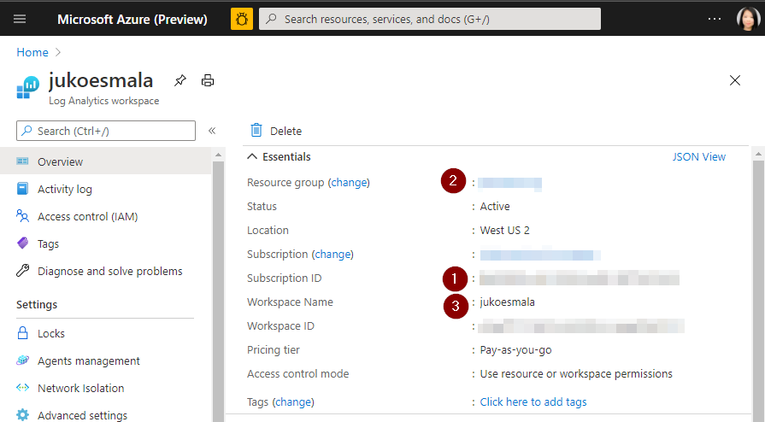
Example
cross product queries!
Log Analytics
cluster('https://ade.loganalytics.io/subscriptions/88a1234b-6cc7-1234-a015-a123bc123456/resourcegroups/myresourcegroup/providers/microsoft.operationalinsights/workspaces/jukoesmala').database('jukoesmala').AzureDiagnostics | take 10
More info: https://docs.microsoft.com/azure/data-explorer/query-monitor-data

Slide 26
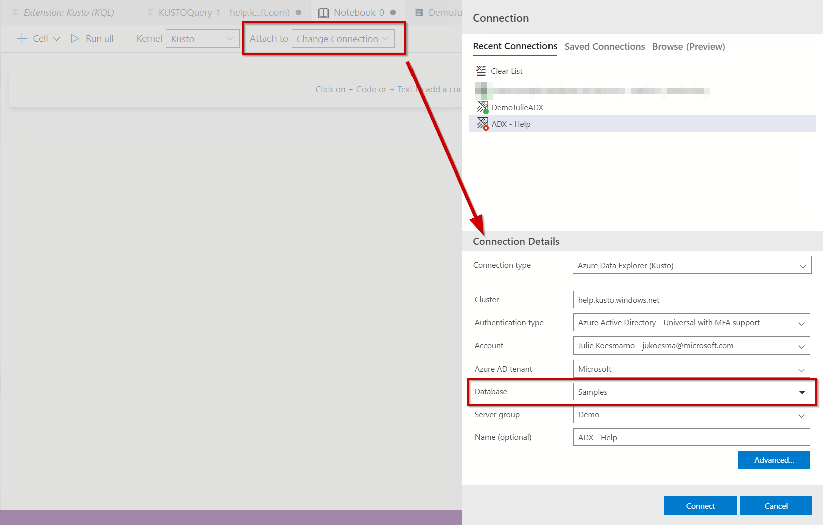
Gotchas
Specify a database in both Query Editor and Notebook via Attach To.
(Note: Unlike SQL platforms, there is no “default” database in Azure Data Explorer, therefore users must provide the database when connecting to a database)
Query Editor
Notebook

Slide 27
Evaluation Form + Raffle Prize
https://bit.ly/3q9ncNu
Julie Koesmarno (@MsSQLGirl)
Program Manager, Microsoft
jukoesma@microsoft.com

Slide 28
4 Kqlmagic
in notebooks

Slide 29
Kqlmagic in notebooks
Install Kqlmagic package in Python first via Azure Data Studio “Manage Packages”, or:
!pip install Kqlmagic --no-cache-dir –upgrade
Quick Usage tips:
%reload_ext Kqlmagic is needed on every notebook session
%kql <connection string> is needed at least once on every notebook session. Also use this to add a connection in the session.
%kql or %%kql is needed to be prefixed before any KQL queries
https://docs.microsoft.com/azure/data-explorer/kqlmagic

Slide 30
Kqlmagic with AAD Device Login
%kql azureDataExplorer://code;cluster='cluster.region';database='DatabaseName'
%kql loganalytics://code;workspace='<WorkspaceID>’
%kql appinsights://code;appid='<AppID>'
Azure Data Explorer
Log Analytics
App Insights
The most asked question!

Slide 31

Gotchas
Have multiple Azure accounts? Make sure you are connected to the cluster / workspace using the correct account.
Working with multiple tenants? You can provide Tenant ID in the connection string instead of “code”. For example: %kql loganalytics://tenant=<TenantID>;workspace='<WorkspaceID>’
Fluent in Python? Try out Azure CLI in Python, and use -try-azcli_login option at the end. %kql loganalytics://code;workspace='<WorkspaceID>' -try-azcli_login

Slide 32
Useful commands
Get version %kql --version
Get help on a topic, e.g. connection %kql --help "conn"
Update configuration %env KQLMAGIC_CONFIGURATION="<settings>"
# Set environment variables using %env magic
%env KQLMAGIC_CONFIGURATION="show_query_time=True;plot_package='plotly';display_limit=100"
# use the following to suppress the Kqlmagic banner:
%env KQLMAGIC_CONFIGURATION="show_init_banner=False"

Slide 33
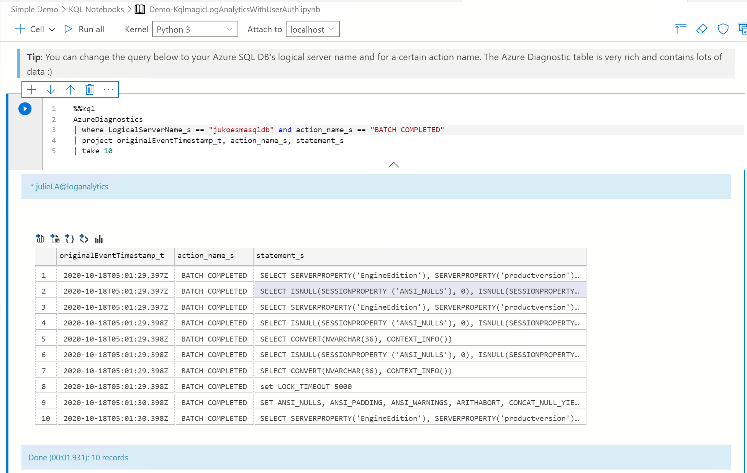
From Azure SQL DB to Log Analytics
Azure SQL DB
read data
event log
Log Analytics

Slide 34
Takeaways

Slide 35
KQL in Azure Data Studio
KQL main use cases:
troubleshooting Azure services
data engineering for big data analytics
KQL is now one of the heterogenous data sources that Azure Data Studio supports:
Efficiency in data exploration and data analysis
Reproducible analyses with Notebooks
DevOps troubleshooting with notebooks
KQL files in your CI/CD pipelines

Slide 36
KQL Experiences in Azure Data Studio
Features | Native Kusto (Preview) | Kqlmagic
Acquisition | Azure Data Studio Extension | Python package
Connection / Object Explorer | Yes – integrated | No
Query Editor | Yes | No
Notebooks | Kusto kernel | Python kernel
Data sources | Azure Data Explorer | Azure Data Explorer Azure Log Analytics Azure App Insights, …
CI/CD | Yes | Yes
Cross Cluster / Product Queries | Yes | Yes
Authentication | AAD (Linked Account to Azure Data Studio) | AAD, Client Secret, UserName+Password, Az CLI
Use Case Efficacy | Simple ●● | Complex ●●●●●

Slide 37
Other useful resources
Azure Data Studio http://aka.ms/getAzureDataStudio
Using Kusto Query Language in Azure Data Studio at Data Exposed, Channel 9 https://www.youtube.com/watch?v=Da1WfrLRl9s
Azure Data Studio Notebooks Power Hour at DPS2020, 3 Dec 2020 https://dataplatformgeeks.com/dps2020/session/azure-data-studio-notebooks-power-hour/
Analyze data in Azure Data Explorer using Kusto Query Language (KQL) extension in Azure Data Studio https://cloudblogs.microsoft.com/sqlserver/2020/09/24/analyze-data-in-azure-data-explorer-using-kusto-query-language-kql-extension-in-azure-data-studio/ Sample files https://github.com/MsSQLGirl/jubilant-data-wizards/tree/main/Simple%20Demo/KQL%20Notebooks
Learn KQL at Pluralsight for Free https://www.pluralsight.com/courses/kusto-query-language-kql-from-scratch
choice

Slide 38
thank you!
Raffle Prize + Evaluation Form https://bit.ly/3q9ncNu
Julie Koesmarno (@MsSQLGirl)
Program Manager, Microsoft
jukoesma@microsoft.com

Slide 39
I’m a SQL DBA. Is KQL relevant for me?
Suki
I’m an app dev on Azure. Why KQL?
Dev
I’m a Data Engineer. How do I use KQL?
I’m at a SQL Saturday, why am I learning KQL?
Roger
Learn KQL in Azure Data Studio at SQL Saturday Singapore Nov 28, 2020 11:30 SGT https://www.sqlsaturday.com/1019

